Slide 1

National Institute of Technology Patna
MINOR PROJECT (Group -17)
CONTEXT BASED SENTIMENT ANALYSIS
WITH SARCASM DETECTION ON TWITTER TWEETS
Submitted By:-
Amarjeet Chaudhary – 1806116
Swapna Sahani – 1806134
Rohit Singh – 1806005
In the Guidance of Dr. Anubha Maurya

Slide 2
Introduction :
Problem Statement : Context based Sentiment Analysis of tweets and retweets with Sarcasm
This Presentation describes the behavior of data for sarcastic , topic from which it belongs to and its sentiment , with the help of CNN,LSTM,NMF,LR and Cosine-Similarity.
We will be able to understand the basic architecture of above mentioned standard algorithm and technique that is being used.

Slide 3
Project Motivation:
We can use Machine Learning in Finance, Medicine, almost everywhere. That’s why we decided to conduct our project around the Machine Learning
As it is the most hot topic where a machine is learning the ability to learn the human nature of talking and thinking. A model is build , that uses the same and implement in real world.
This project was motivated by our desire to investigate the complete description of the tweets

Slide 4
Work performed :
Sarcasm Detection
Context Classification
Sentiment Analysis
Cosine Similarity
Semantic Similarity using Spacy model

Slide 5
Procedure :
Logistic Regression(LR)
Convolutional Neural Network (CNN)
Non-negative Matrix Factorization (NMF)
Long Short Term Memory (LSTM)
TfidfVectorizer
Cosine Similarity

Slide 6
Data Flow Diagram :
Input 1
(Tweet)
Input 2
(Retweet)
Output
<string>
Sentiment
Analysis
Module
Output
(binary)
Context
Classification
module
Data
Filter
For
sentiment
Cosine
Similarity
Module
Output
<percentage>
Sarcasm
Module
Output
<percentage>

Slide 7
Description of Term Used in Data Flow Diagram :
Input1 and Input2:
These are the tweet and retweet respectively which will be used as input for the module.
ContextClassificationModule:
This will take Input1 and Input2 as input and gives output as a string that classifies the Input1 and Input2 according to their context.
SarcasmModule:
This will take Input1 and Input2 as input and gives output as the percentage of sarcastic behavior of input.
CosineSimilarityModule:
It will take Input1 , Input2 and output from ContextClassificationModule which is used to calculate the similarity percentage between two inputs which will be further used to filter out the necessary data.
SentimentAnalysisModule:
It will take the filtered data and output from SarcasmModule to calculate the sentiment for the input,output will be in the vector of binary form.

Slide 8
Algorithm :
Def comp(s, threshold, value):
# if sarcastic_value > threshold return false to reverse the polarity else return true for no change
# value used here is the sarcastic value obtained using SarcasmModule()
if(value > threshold):
return false
else:
return true
Def model(s1, s2):
data = [s1, s2]
# STEP 1 find the topic for the data
topic_decided = ContextClassificationModule(s1, s2)
# STEP 2 calculate the similarity between data
similarity_percentage = CosineSimilarityModule(s1, s2, topic_decided)
# STEP 3 calculate the sarcastic percentage for each data
sarcasm_percentage = SarcasmModule(s1, s2)
# STEP 4 calculate sentiment using previous output as input along with comp() function for reverse the output where needed
final_output = SentimentAnalysisModule(s1, s2, sarcasm_percentage, comp)
NOTE: ContextClassificationModule() , CosineSimilarityModule() , SarcasmModule() , SentimentAnalysisModule()
are the modules created and takes input as maintained

Slide 9
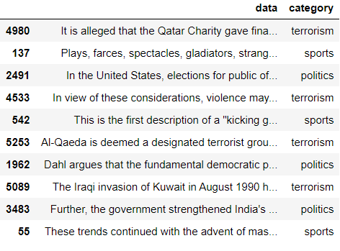
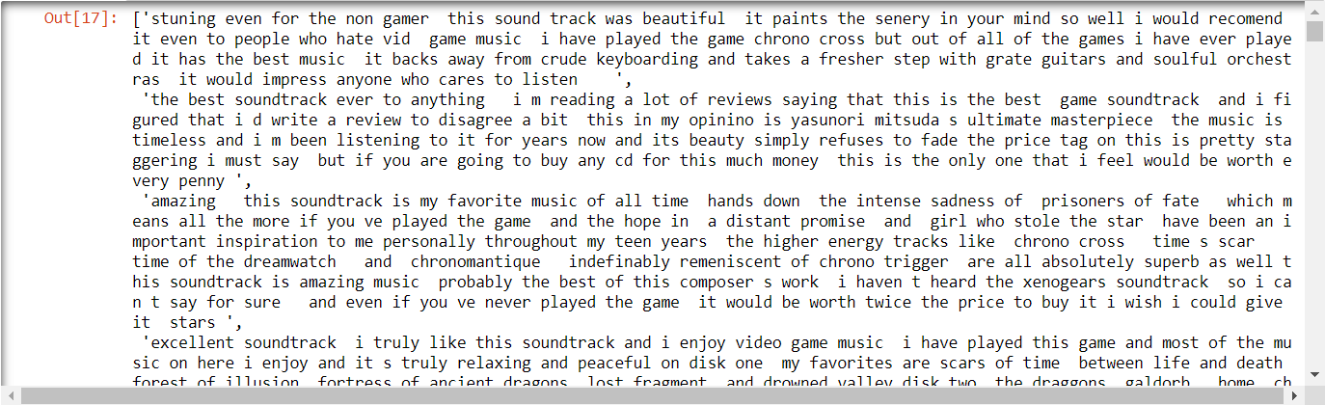
Datasets:
Dataset-I for Context classification:
We have created a dataset of 5434 sentences from Wikipedia of different
Topics such as ‘sports’, ‘politics’ and ‘terrorism’. Dataset-I
There are approximate equal sentences of each topic (approximately
1800 from each)
Dataset – II for Sarcasm Detection:
We have a data set of 26709 tweets in English coming from Kaggle.
It is composed of 2 columns that are headline and class.
class contains a binary value, 0 if the tweet is not sarcasm,
1 if the tweet is sarcasm. Dataset-II
Dataset-III for Sentiment Analysis:
We have a dataset of 20000 tweets in English coming from the bz
format file where 9743 negative and 10257 positive.
It contains paragraphs for positive tweets and negative tweets and 0 if tweet
is negative and 1 if tweet is positive.
Headline | is_sarcastic
former versace store clerk sues over secret 'b... | 0
the 'roseanne' revival catches up to our thorn... | 0
mom starting to fear son's web series closest ... | 1
boehner just wants wife to listen, not come up... | 1
j.k. rowling wishes snape happy birthday in th... | 0
Dataset-III

Slide 10
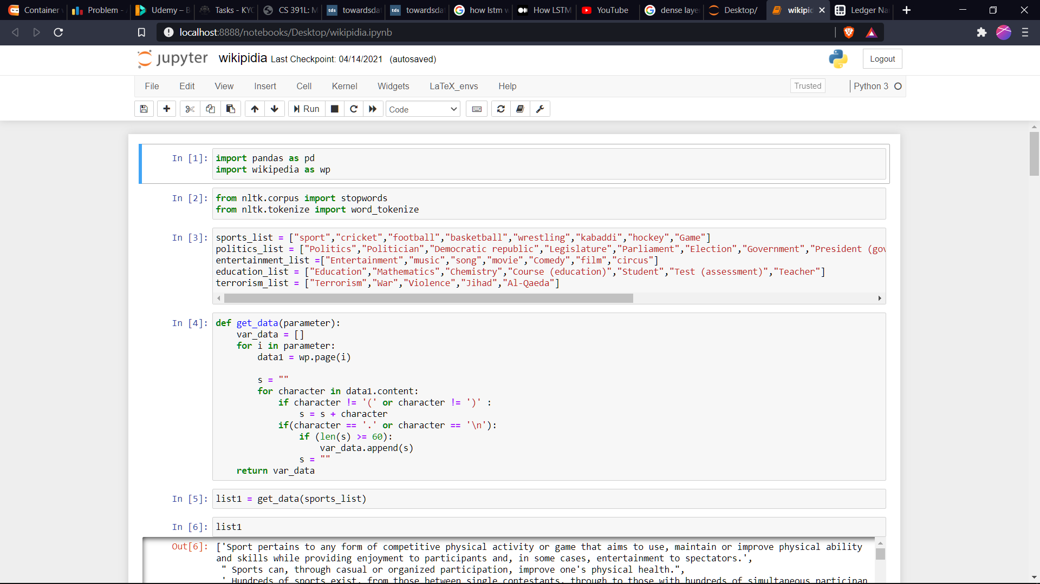
1. Data Generation for Context Classification :
[ fig 1.1 ]
Above fig. Show the creation of data using Wikipedia module in python

Slide 11
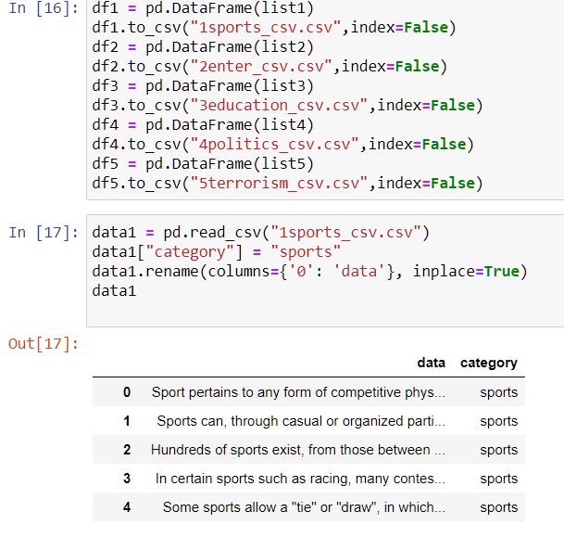
Converting To Csv :
[ fig 1.2 ]
Converting the data to csv format for further use

Slide 12
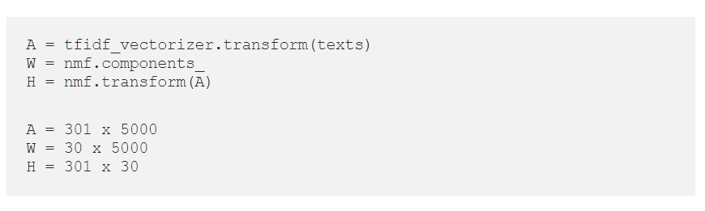
Creating Context classification Module with NMF:
Non-Negative Matrix Factorization (NMF) is an unsupervised technique so there are no labeling of topics that the module will be trained on. The way it works is that, NMF decomposes (or factorizes) high-dimensional vectors into a lower-dimensional representation. These lower-dimensional vectors are non-negative which also means their coefficients are non-negative.
Using the original matrix (A), NMF will give you two matrices (W and H). W is the topics it found and H is the coefficients (weights) for those topics. In other words, A is articles by words (original), H is articles by topics and W is topics by words.
So assuming 301 articles, 5000 words and 30 topics we would get the following 3 matrices:

Slide 13
Processing with TfidfVectorizer :
TfidfVectorizer(max_df=max_df,min_df=min_df,stop_words='english')
max_df is used for removing data values that appear too frequently, also known as "corpus-specific stop words".
min_df is used for removing terms that appear too infrequently.
Example :
max_df = 0.90 means "It ignores terms that appear in more than 90% of the documents".
max_df = 90 means "It ignores terms that appear in more than 90 documents".
min_df = 0.02 means "ignore terms that appear in less than 2% of the documents".
min_df = 2 means "ignore terms that appear in less than 2 documents".

Slide 14
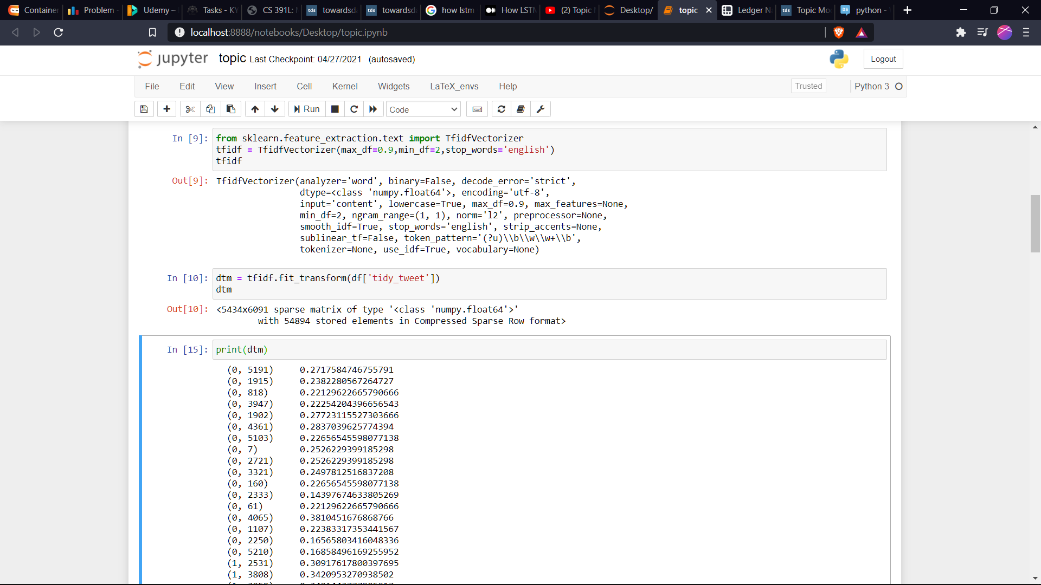
Word to Real Number Output :
[ fig 1.3 ]

Slide 15
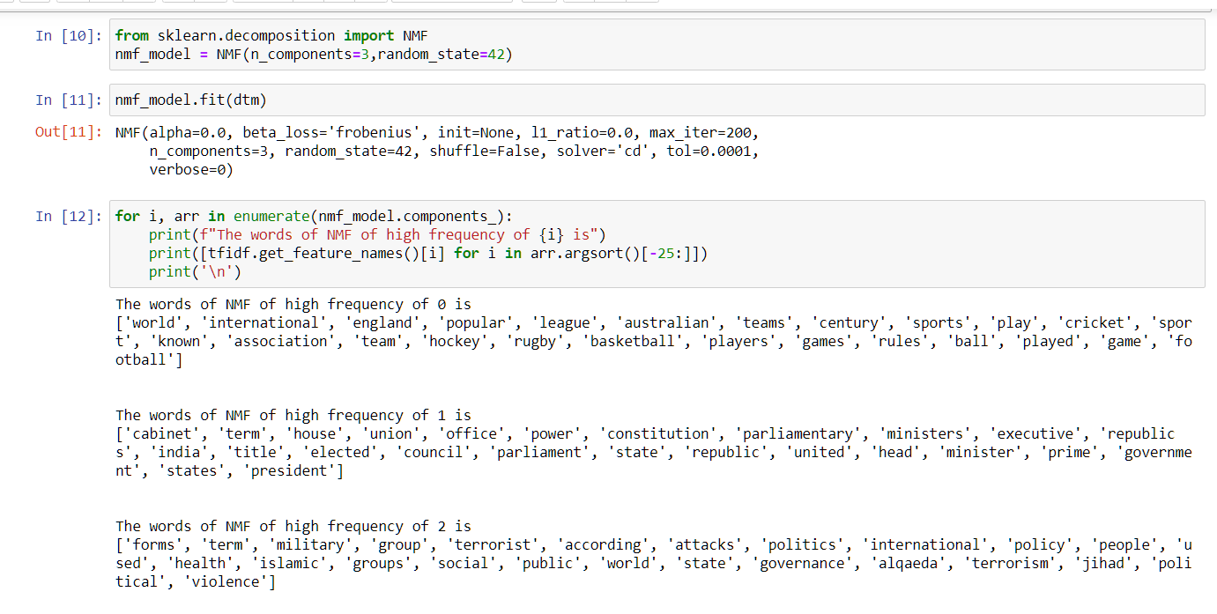
Snippet for Context Classification module component :
[ fig 1.4 ]

Slide 16
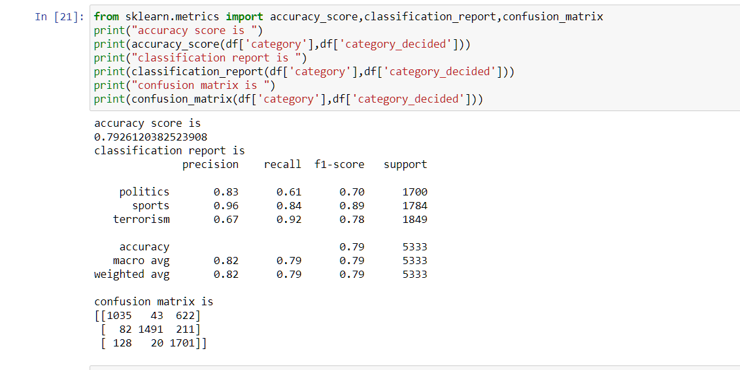
Output :
[ fig 1.5 ]
Output shows the classification report of context classification module

Slide 17
2. Sarcasm Detection Module With CNN:
A Convolutional Neural Network (CNN) is a Deep Learning algorithm which can take in an input image, assign importance (learnable weights and biases) to various aspects/objects in the image and be able to differentiate one from the other. The pre-processing required in a ConvNet is much lower as compared to other classification algorithms. While in primitive methods filters are hand-engineered, with enough training, ConvNets have the ability to learn these filters/characteristics.
The architecture of a ConvNet is analogous to that of the connectivity pattern of Neurons in the Human Brain and was inspired by the organization of the Visual Cortex. Individual neurons respond to stimuli only in a restricted region of the visual field known as the Receptive Field. A collection of such fields overlap to cover the entire visual area.

Slide 18
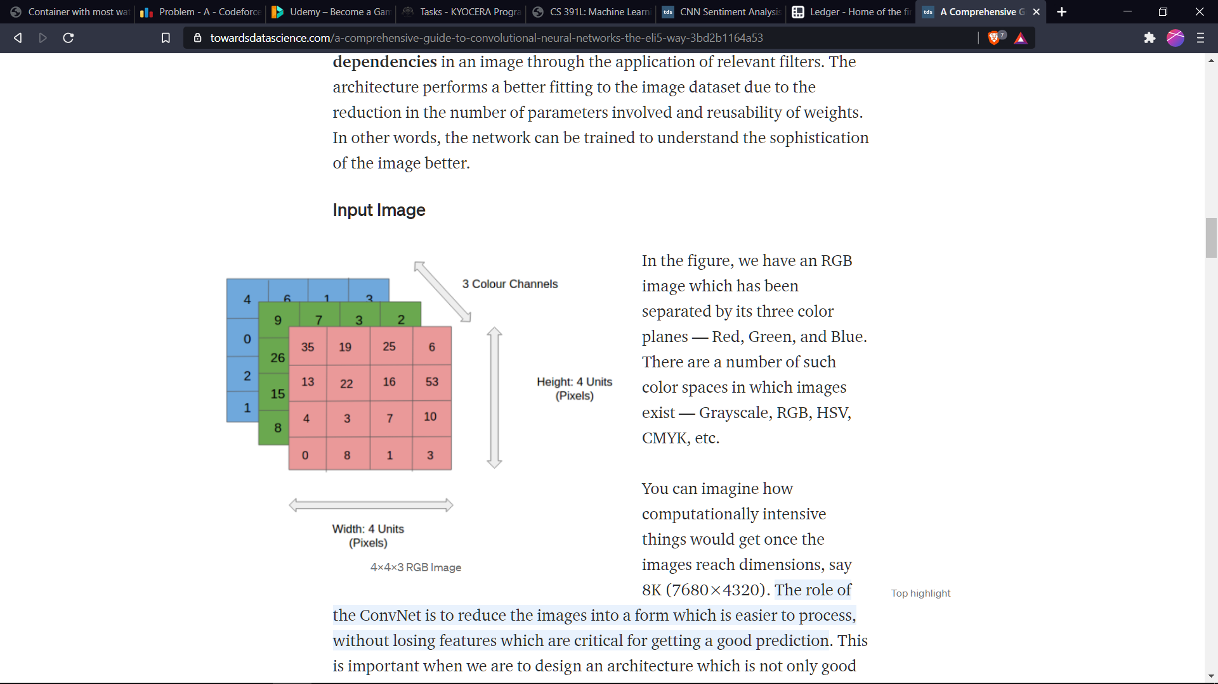
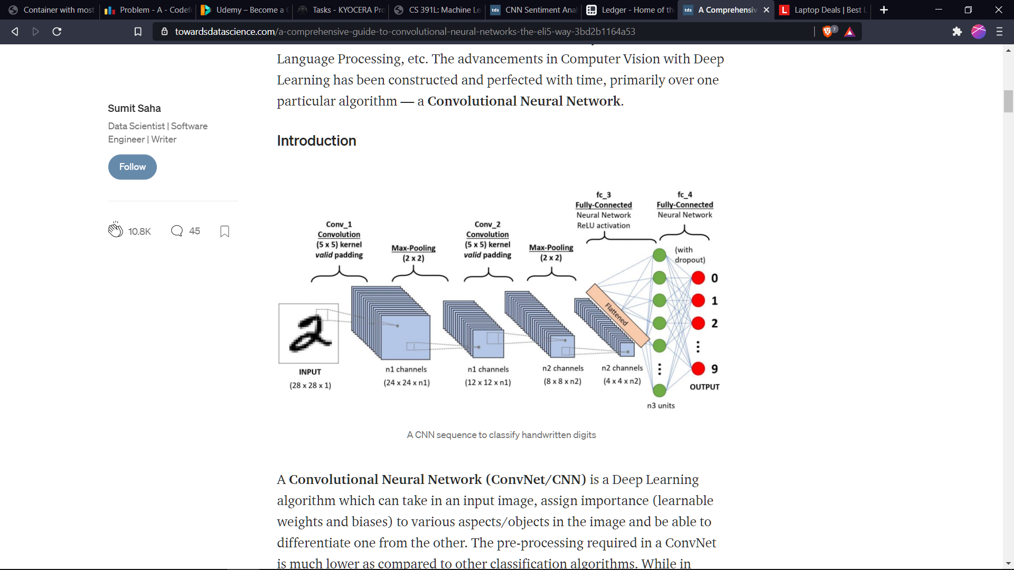
Working of CNN :
Matrix Value is updated as per the neuron weight
Updation formula.
22 activated
[ fig 2.1 reference : towardsdatascience]

Slide 19
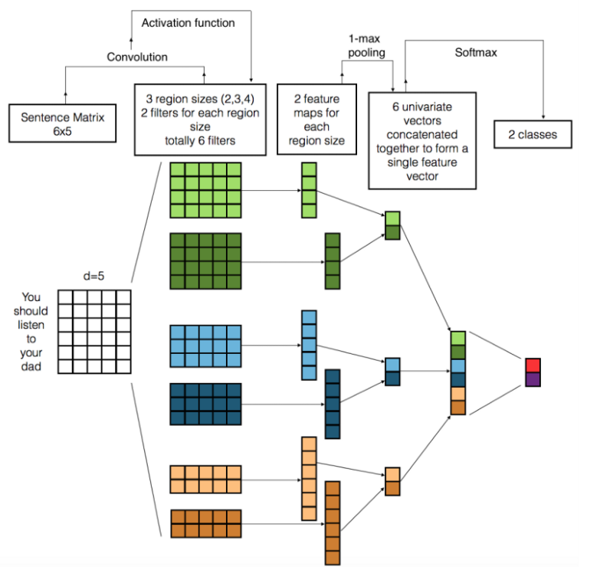
How it works for words ?
Images are just some points in space,just like
the word vectors are. By representing each word
with a vector of numbers of a specific length
and stacking a bunch of words on top
of each other, we get an “image.” Computer vision
filters usually have the same width and height
and slide over local parts of an image. In NLP,
we typically use filters that slide over word
embeddings — matrix rows. Therefore, filters
usually have the same width as the length of the word embeddings.
[ fig 2.2 reference : machinelearningmastery]

Slide 20
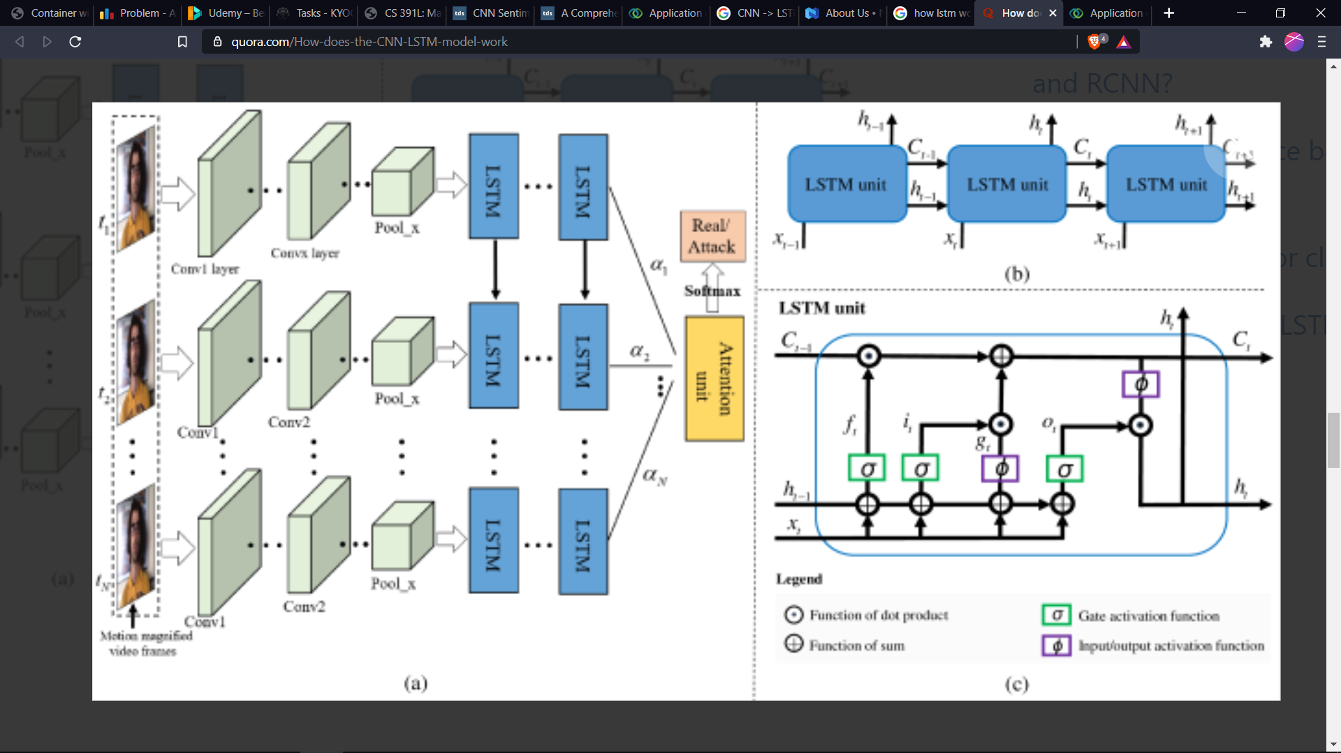
2.1 Adding New Layer(LSTM) in the module :
[ fig 2.3 reference : quora]

Slide 21
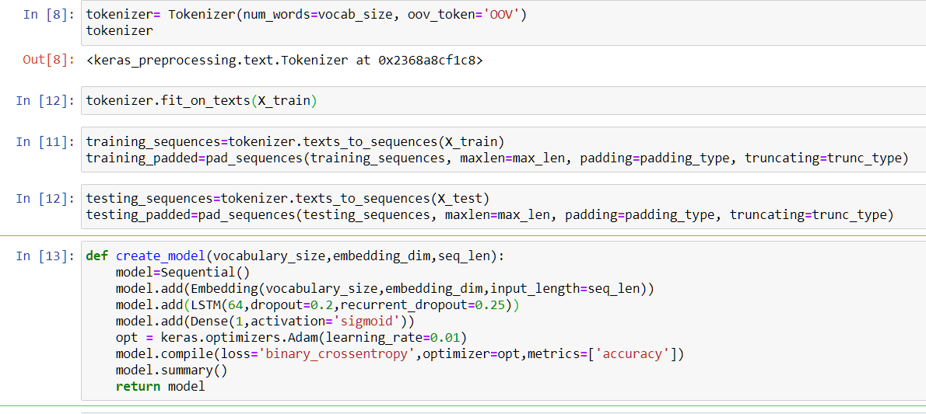
Snippet of Sarcasm Detection module :
[ fig 2.4 ]

Slide 22
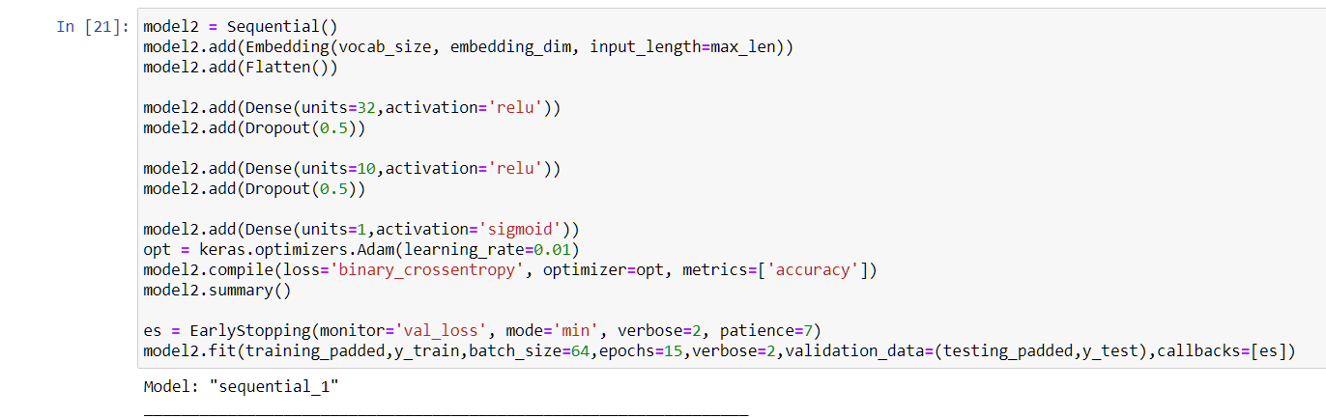
2.2 Snippet of Sarcasm Detection module2 :
[ fig 2.5 ]
Dropout is a technique where randomly selected neurons are ignored during training. They are “dropped-out” randomly. This means that their contribution to the activation of downstream neurons is temporally removed on the forward pass and any weight updates are not applied to the neuron on the backward pass.

Slide 23
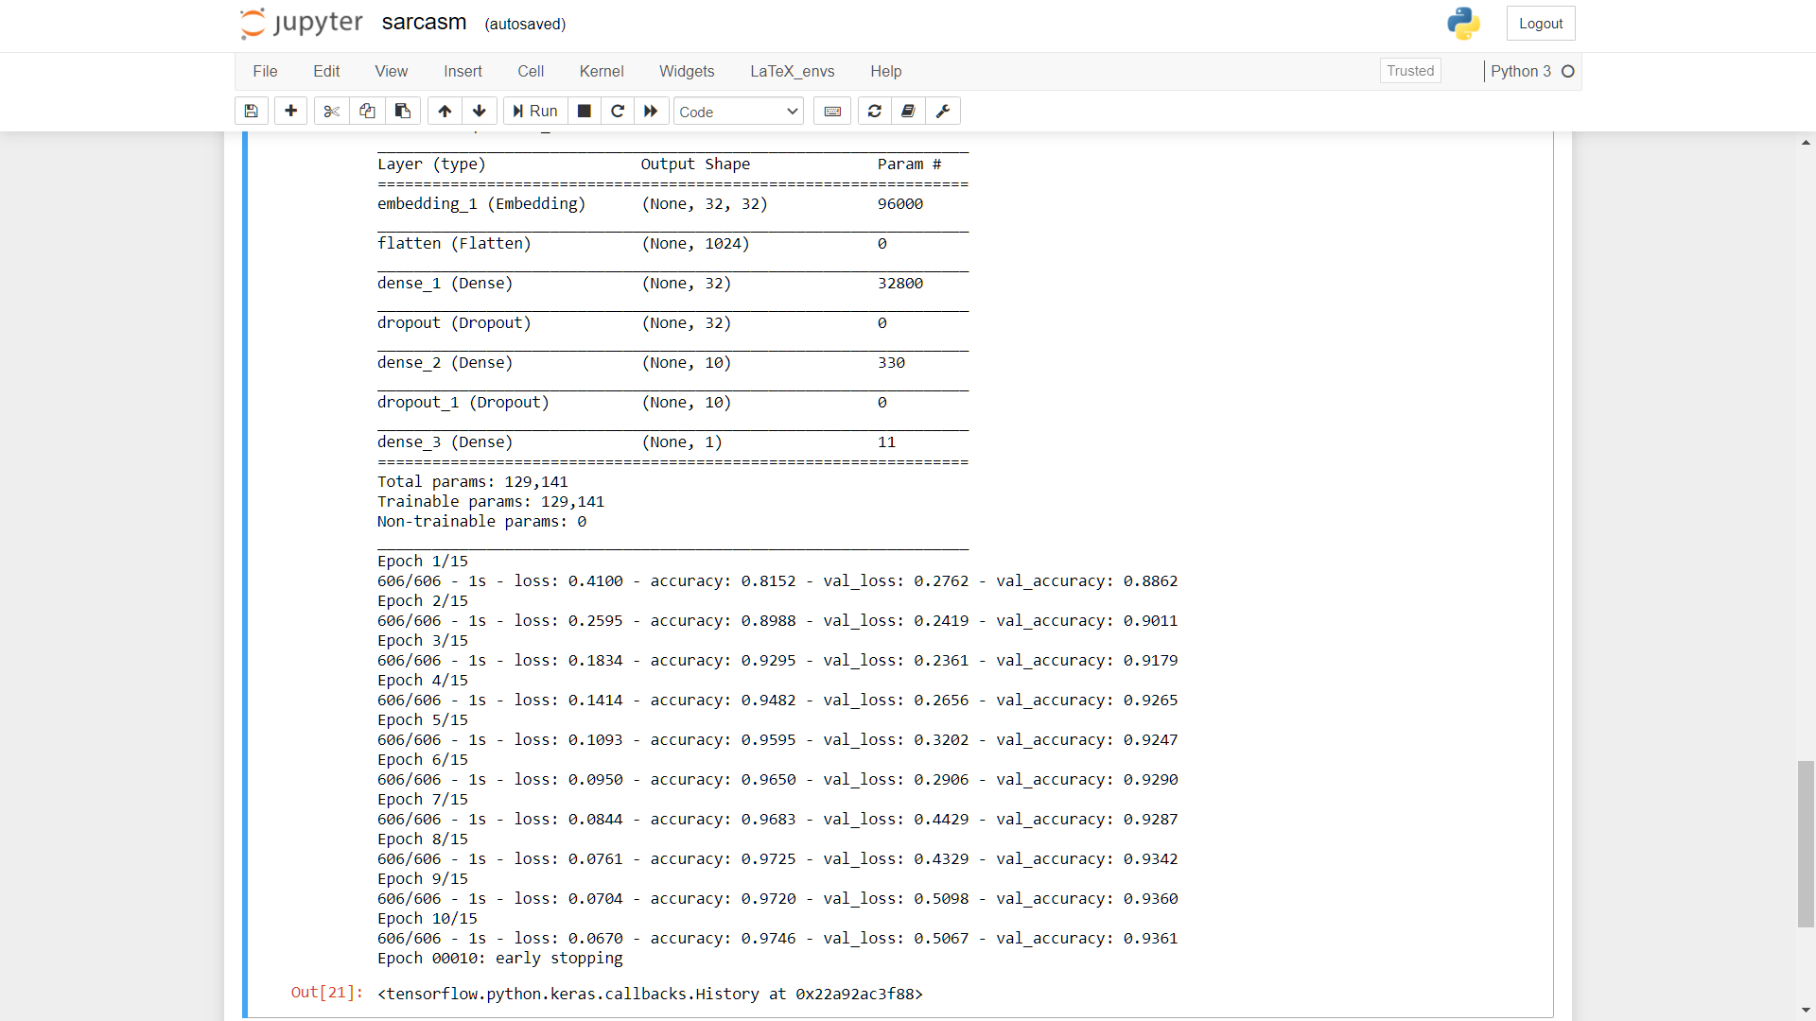
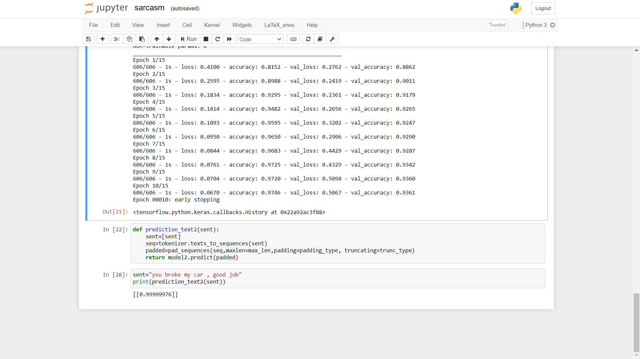
Sarcasm Detection module Output Accuracy :
[ fig 2.6 ]

Slide 24
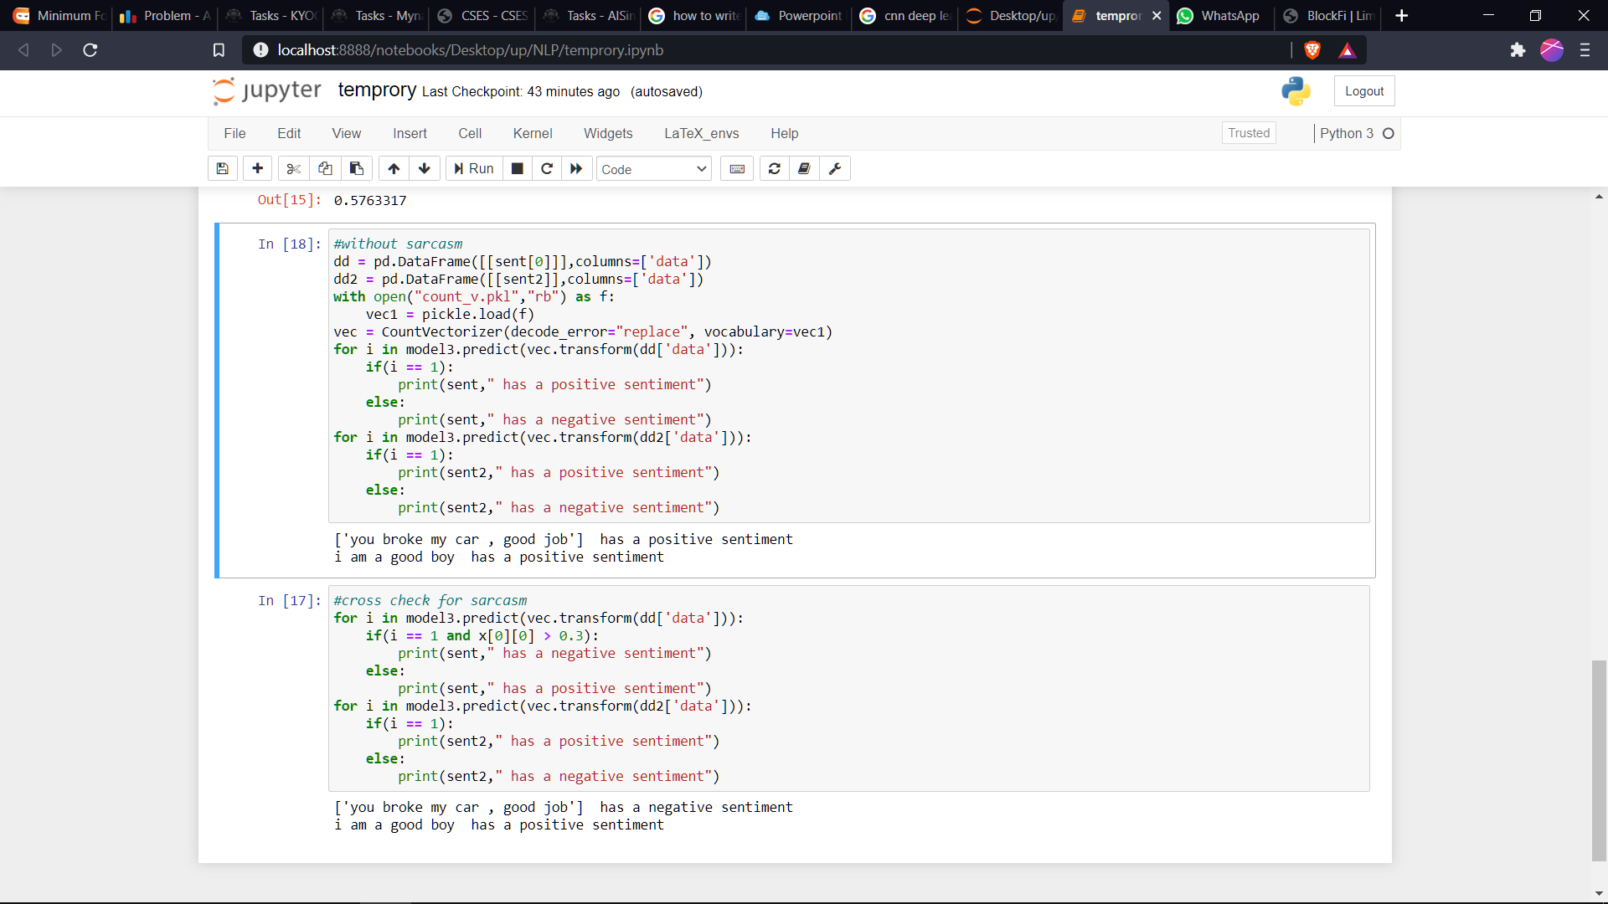
How sarcastic statement changes the sentiment:
fig 0.2

Slide 25
3. Sentiment Analysis Module :
Logistic Regression is a Machine Learning algorithm which is used for the classification problems, it is a predictive analysis algorithm and based on the concept of probability. It is based on most likelihood parameter
We can call a Logistic Regression a Linear Regression module but the Logistic Regression uses a more complex cost function, this cost function can be defined as the ‘Sigmoid function’ or also known as the ‘logistic function’ instead of a linear function.

Slide 26
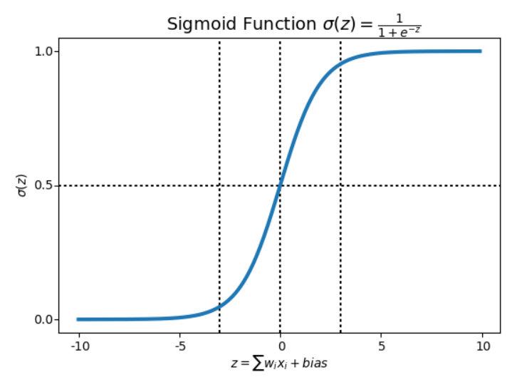
Sigmoid Function :
In order to map predicted values to probabilities, we use the Sigmoid function. The function maps any real value into another value between 0 and 1. In machine learning, we use sigmoid to map predictions to probabilities.
[ Graph of sigmoid function ]

Slide 27
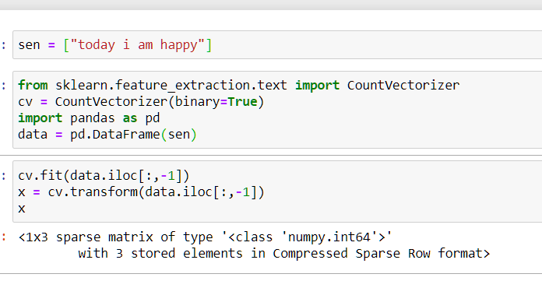
Input Processing :
“Today I am happy”
tokenizer
‘today’ , ‘I’ , ‘am’ , ‘happy’
Creating vocabulary from data
‘among’ , ‘ants’ , ……… , ‘happy’ , ‘zoo’
Encoding sparse matrix
[ fig 3.2 ]
‘among’ , ‘ants’ , ……… , ‘happy’ , ‘zoo’
[0,…,0,1,0,…1,0,.....1,1,…..,1,0,…..1]
cv.fit() - it creates a vobulary over raw
Input of the document
cv.transform() - it transform the tokens
Into sparse matrix
Processing bag of words

Slide 28
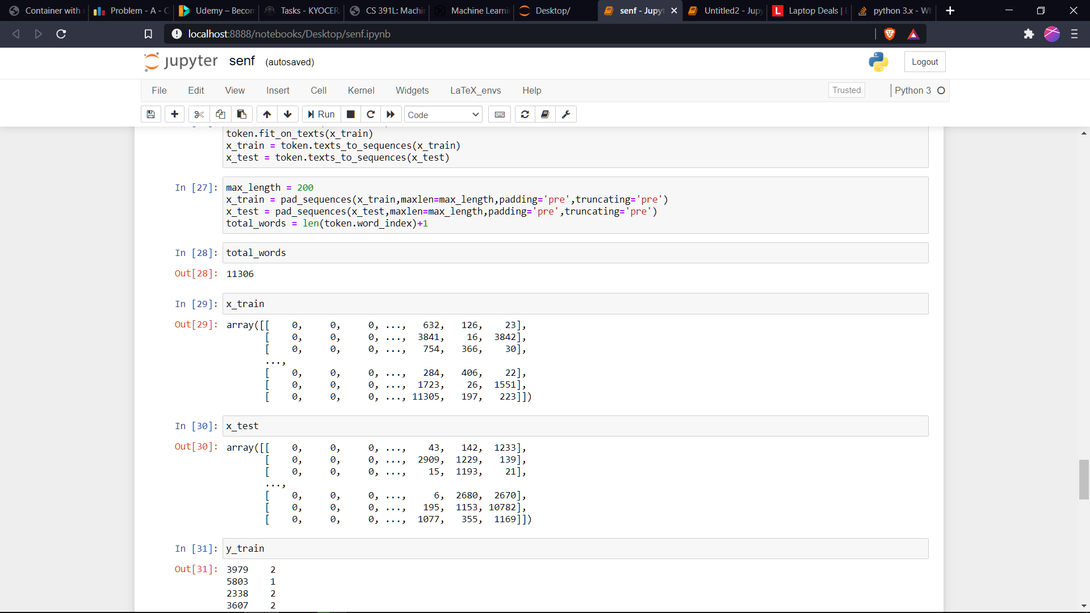
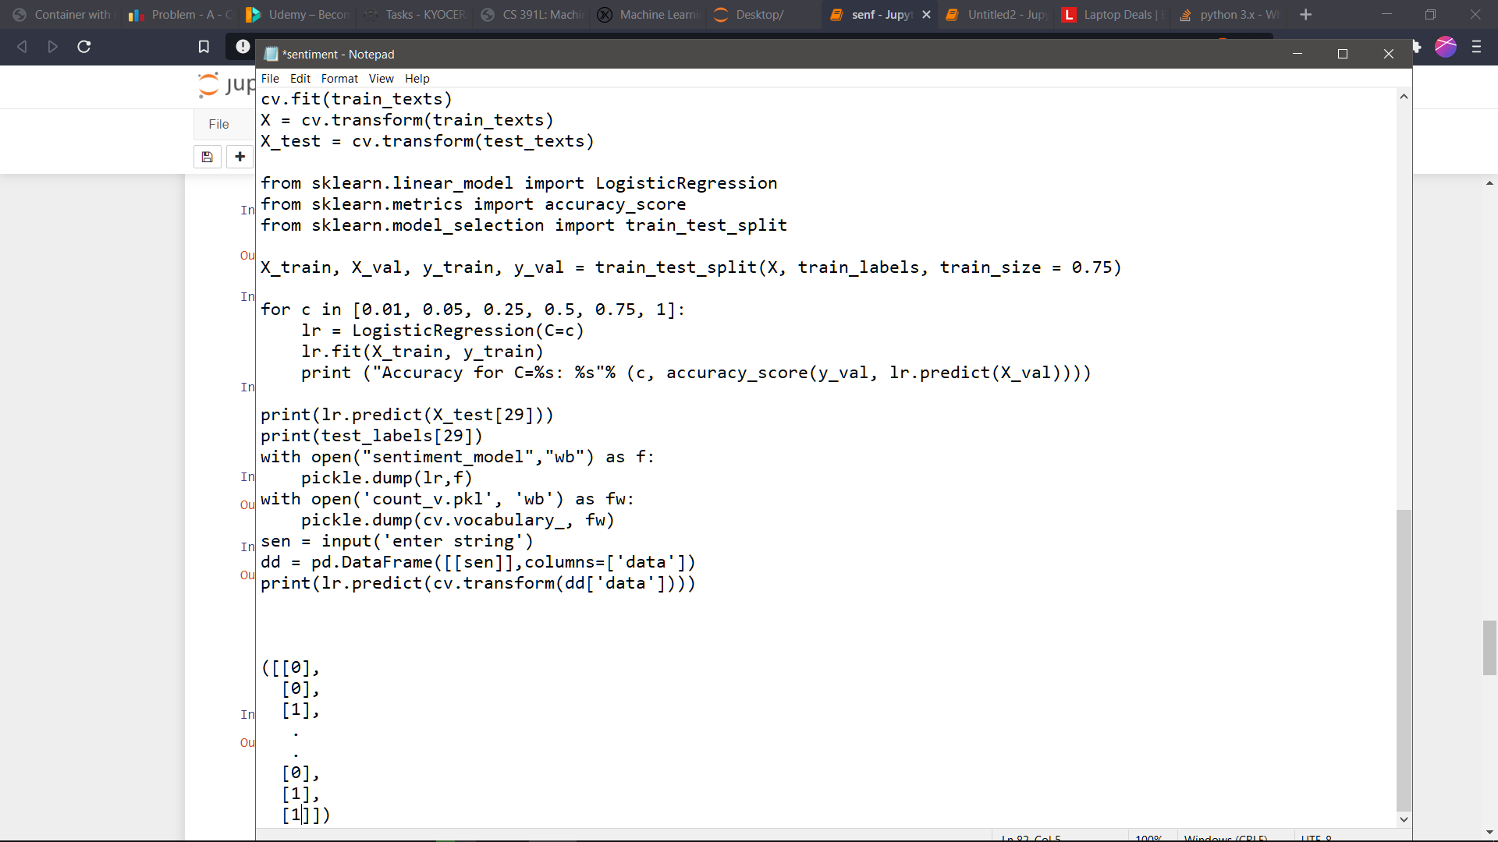
How Model.fit() works :
y_train
from sklearn.linear_model import LogisticRegression
lr = LogisticRegression(C=c)
lr.fit(X_train, y_train)
print (accuracy_score(y_val,lr.predict(X_val)))
Where C is the inverse regularization parameter
[ fig 3.3 ]

Slide 29
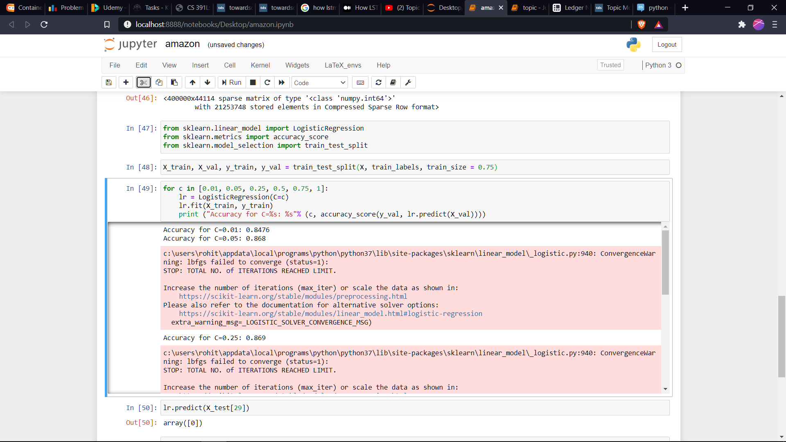
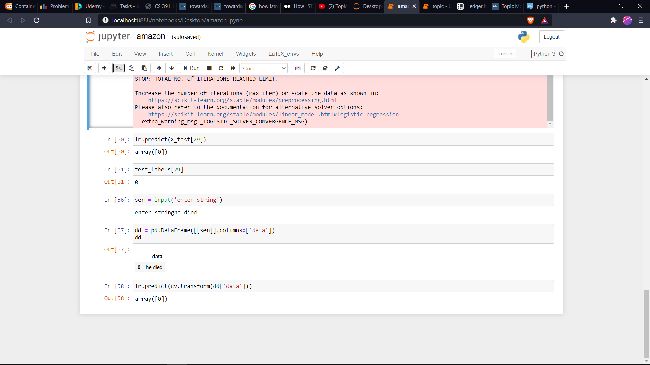
Output Snippet for Sentiment Module :
[ fig 3.4 ]

Slide 30
4. Cosine Similarity :
Vectors and matrices provide a natural way to represent the occurrence of words in a document/query
In the text analysis, n is usually the size of the vocabulary, so each dimension corresponds to a unique word
Doc 1= “information retrieval”
Doc 2 = “computer information retrieval”
Doc 3 = “computer retrieval”
Vocabulary: information, retrieval, computer
Doc 1 = <1, 1, 0>
Doc 2 = <1, 1, 1>
Doc 3 = <0, 1, 1>

Slide 31
Term1:information
Doc1
Doc1=<1, 1, 0>
Doc2-<1, 1, 1>
Doc3=<0, 1, 1>
Doc2
Term2:retrieval
Doc3
Term3:computer
[ fig 4.1 ]

Slide 32
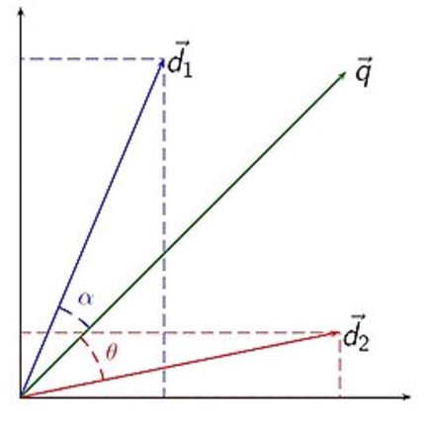
Working with query :
Used in information retrieval to determine which document (d₁ or d₂) is more similar to a given query q
Documents and queries are represented in the same space.
Angle (or cosine) is a proxy for similarity between two vectors
[ calculating cosine of angle between two vector ]

Slide 33
Formula :
Cos(d1,q) = vector_multiplication(d1,q) / (|d1|*|q|)
Let’s → d1 = <a1, a2, a3> and q =<b1, b2, b3>
Cosine(d1,q) = ((a1b1+a1b2+…...+a3b3)/(sqrt(a1a1+a2a2+a3a3)sqrt(b1b1+b2b2+b3b3))
Similarly we can calculate for Cosine(d2,q)
Note : Cosine(a,b) = Cosine(b,a) , Cosine(theta) = Cosine(-theta)
Dis1 = cosine(d1,q)
Dis2 = cosine(d2,q)
Compare Dis1 and Dis2, smaller will be nearer to the query vector.

Slide 34
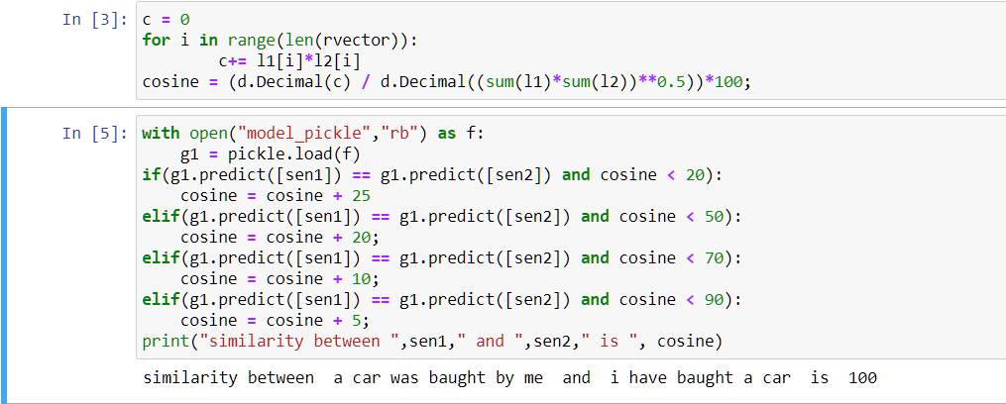
Output Snippet :
[ fig 4.2 ]

Slide 35
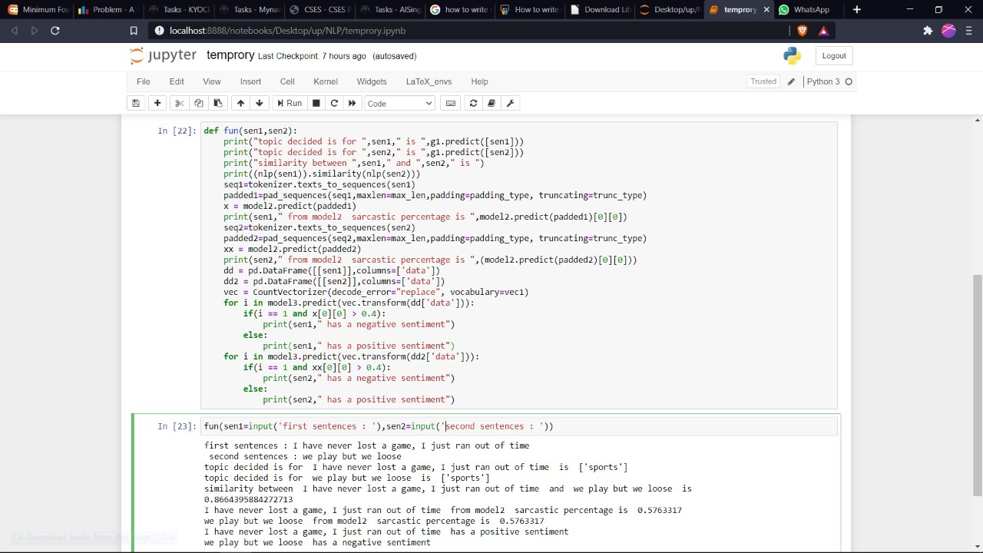
5. Final Output of Combined Module :
[ fig 5 ]

Slide 36
Conclusion :
Since we have the data from the user from any social networking site eg:twitter,facebook etc, we will be able to analyze the similarity between two comments whether the newly comments are in the context for the older one ,eg : we can consider for tweets and retweets
we can analyze that the the semantic behavior of two comments are in the same context or not.
We can also analyze that the older and newly comments are in the same context or not,
sometimes there is chance that some adds will be there for any specific person which is not meaningful for the older comments.
We can calculate the cosine similarity between the comments for various page that how much they are similar to one another

Slide 37
Reference :
[1] Arbel, N. (2018, Dec 21). How LSTM networks solve the problem of vanishing gradients. Retrieved from medium: https://medium.datadriveninvestor.com/how-do-lstm-networks-solve-the-problem-of-vanishing-gradients-a6784971a577
[2] Borcan, M. (2020, Jun 8). TF-IDF Explained And Python Sklearn Implementation. Retrieved from towardsdatascience: https://towardsdatascience.com/tf-idf-explained-and-python-sklearn-implementation-b020c5e83275
[3] Narkhede, S. (2018, May 17). Understanding Logistic Regression. Retrieved from towardsdatascience: https://towardsdatascience.com/understanding-logistic-regression-9b02c2aec102
[4] Pant, A. (2019, Jan 22). Introduction to Logistic Regression. Retrieved from towardsdatascience: https://towardsdatascience.com/introduction-to-logistic-regression-66248243c148
[5] Saha, S. (2018, Dec 15). A Comprehensive Guide to Convolutional Neural Networks — the ELI5 way. Retrieved from towardsdatascience: https://towardsdatascience.com/a-comprehensive-guide-to-convolutional-neural-networks-the-eli5-
way-3bd2b1164a53
[6] Salgado, R. (2020, Apr 16). Topic Modeling Articles with NMF. Retrieved from medium: https://medium.com/@robert.salgado
[7] sawant, m. (2019, Jul 28). Text Sentiments Classification with CNN and LSTM. Retrieved from medium: https://medium.com/@mrunal68/text-sentiments-classification-with-cnn-and-lstm-f92652bc29fd
[8] sklearn.decomposition.NMF. (2007). Retrieved from scikit-learn: https://scikit- learn.org/stable/modules/generated/sklearn.decomposition.NMF.html
[9] sklearn.feature_extraction.text.TfidfVectorizer. (2007). Retrieved from scikit-learn: https://scikit-
learn.org/stable/modules/generated/sklearn.feature_extraction.text.TfidfVectorizer.html

Slide 38
THANK YOU

